Slide 1


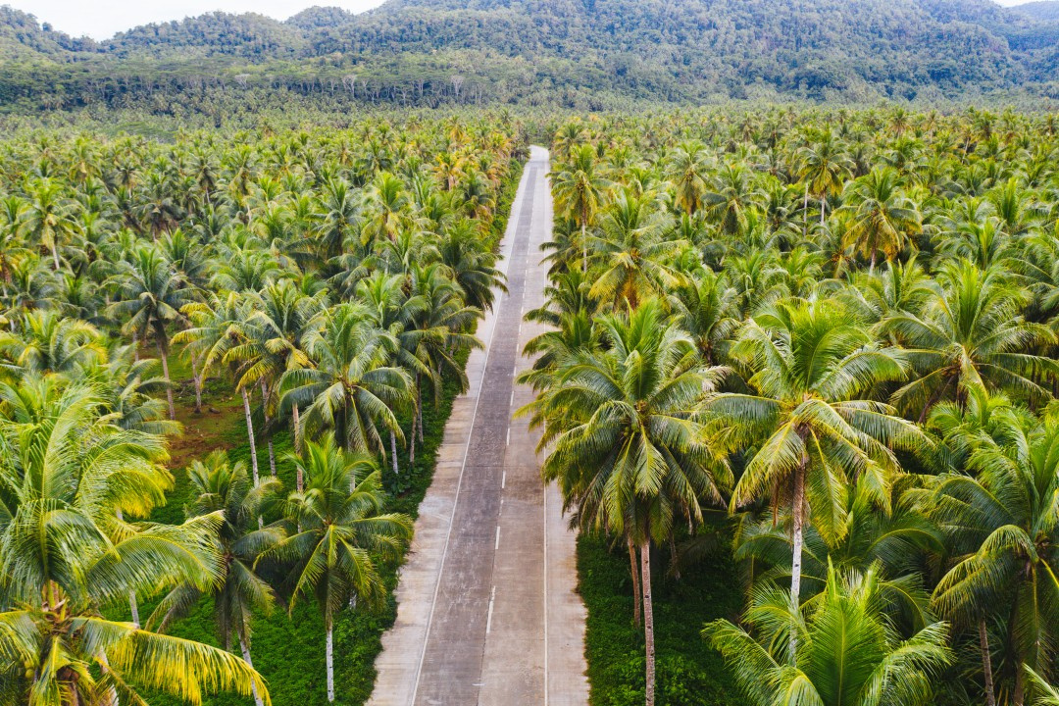

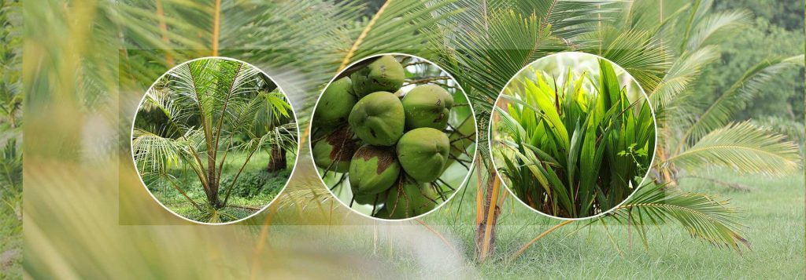


Coco Guard
deep learning of coconut diseases and fertility check​
Project Proposal Presentation​
Project ID: RP-24-25J-267​

Slide 2

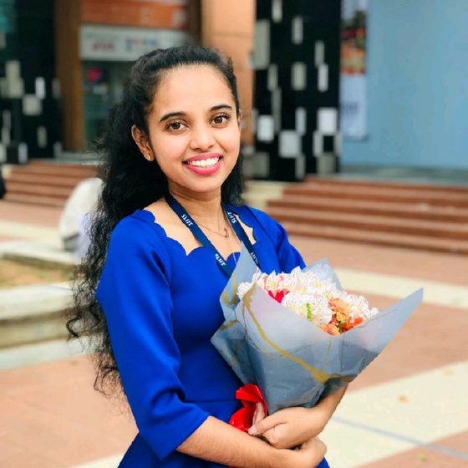

Project ID: RP-24-25J-267​
Meet Our Team
Ms.Shashika Lokuliyana
Ms.Pipuni Wijesiri
Supervisor
Co - Supervisor

Slide 3
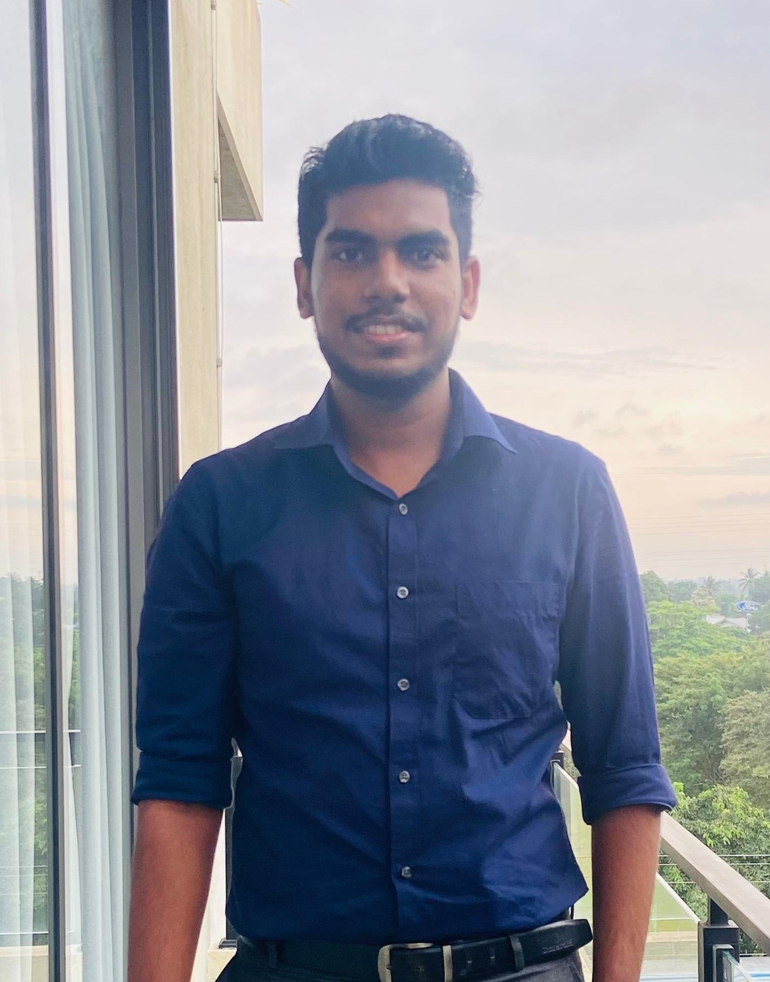
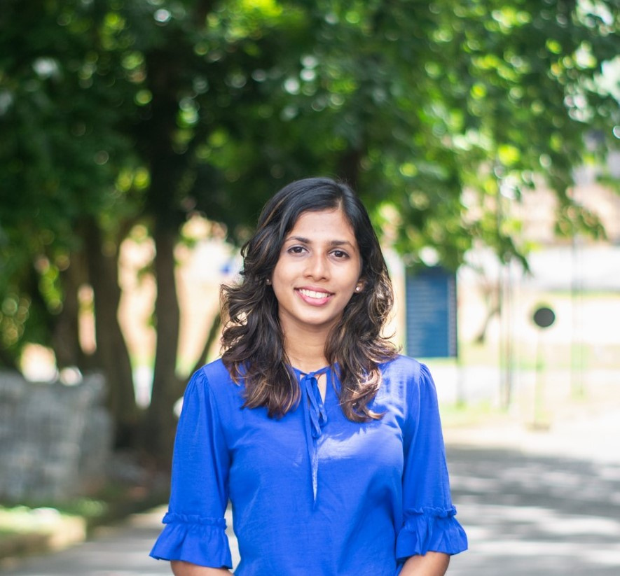
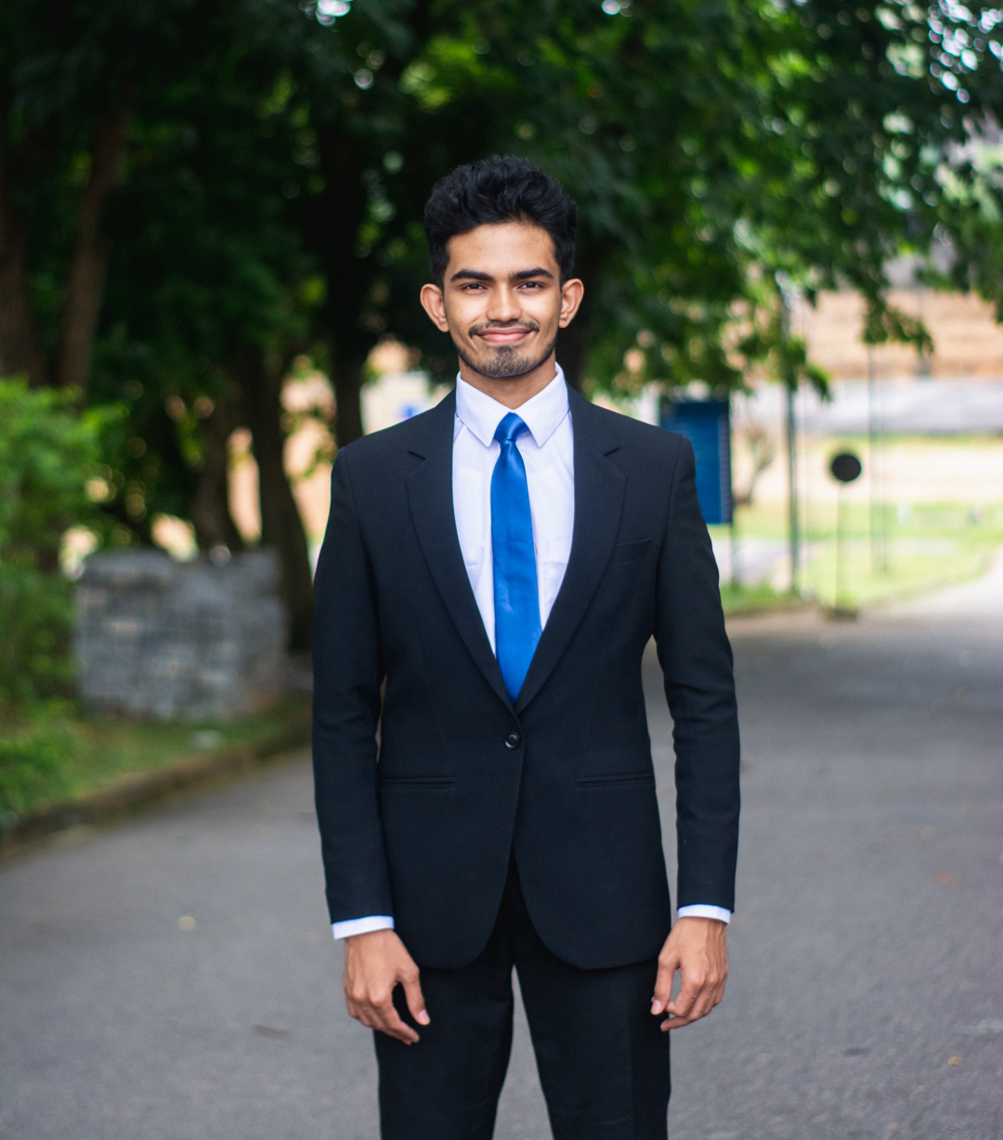
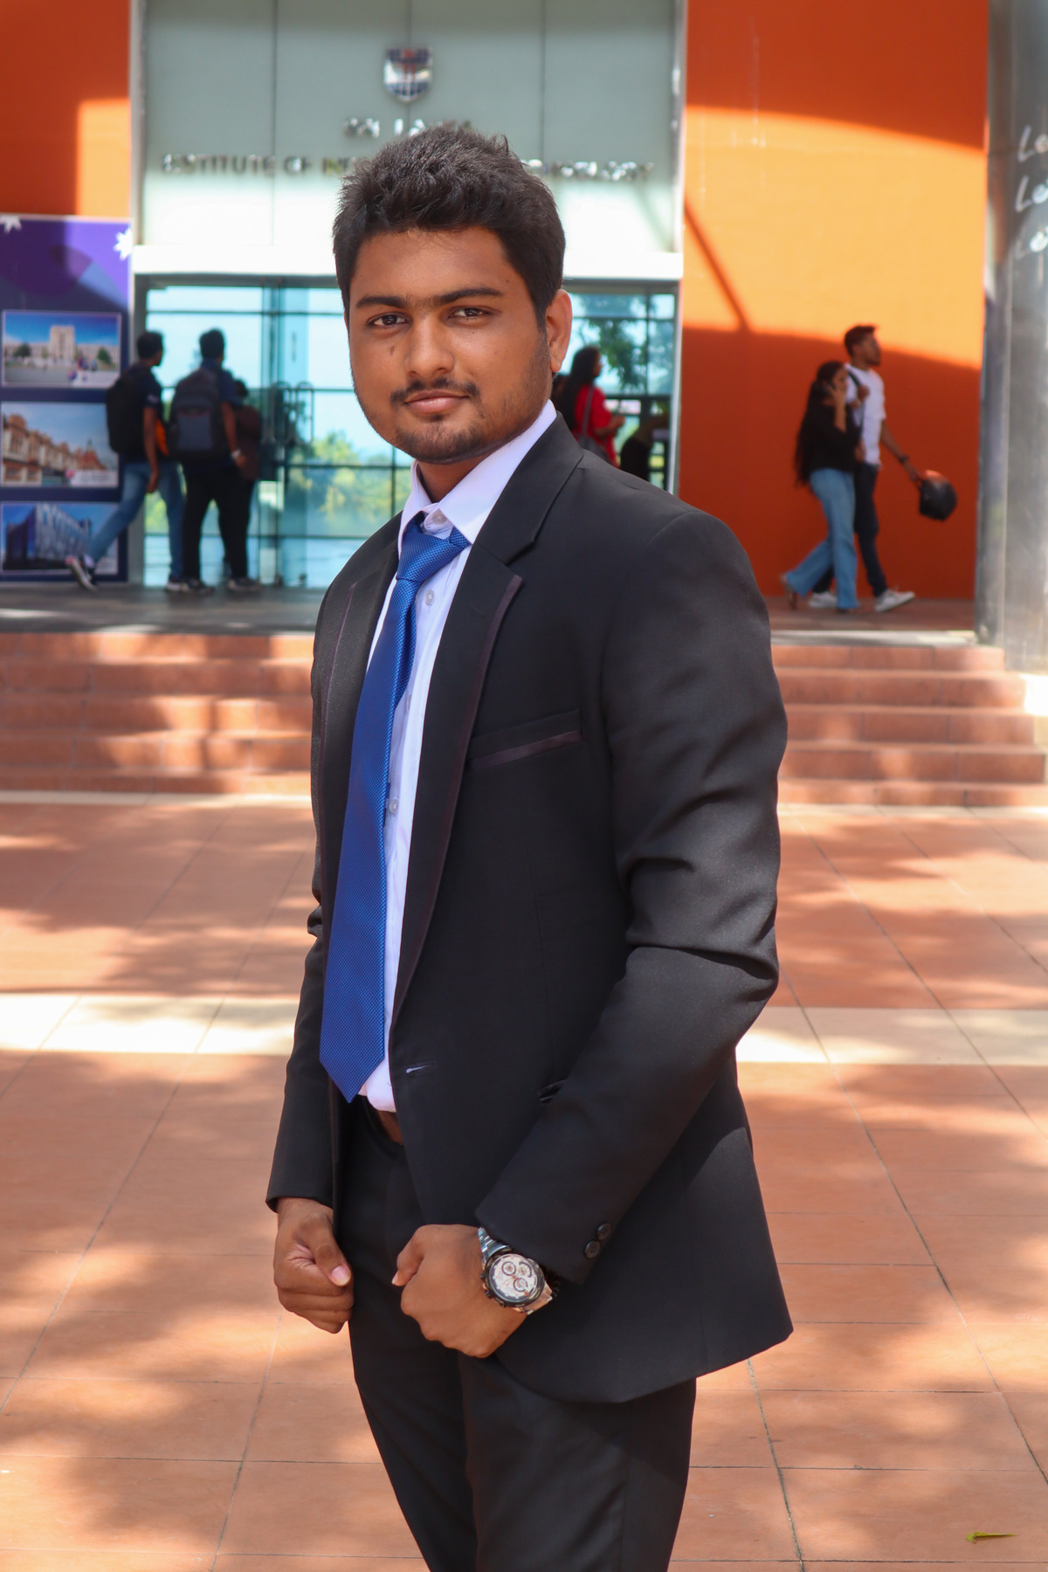
Project ID: RP-24-25J-267​
Meet Our Team
Balasooriya R. C.​
Gunarathne M. M. S. U.
Silva T.C.D.​
Adithya E.L.A.Y.
IT21348648
IT21305696
IT21296932​
IT21193736
Team Leader

Slide 4
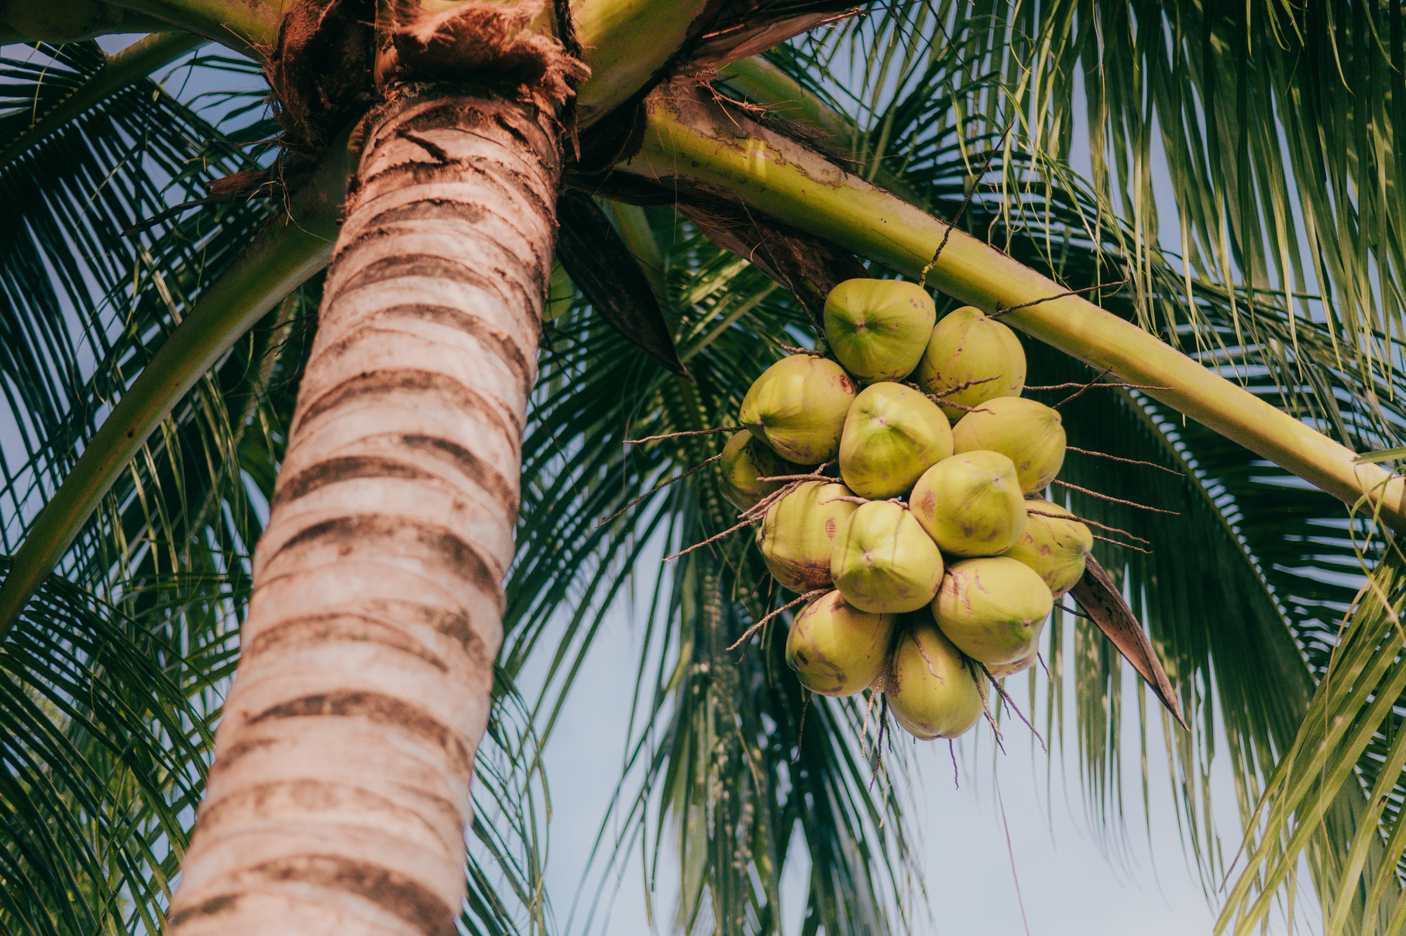

Project ID: RP-24-25J-267​
Introduction
Coconut trees are a versatile and vital crop in Sri Lanka. ​
Known as the "Tree of Life," every part of the coconut tree, from the roots to the leaves, is utilized, making it a crucial resource for both economic and cultural reasons.​
12%
of Sri Lanka's Total Agricultural land was used in 2017
Coconut trees are a significant export for Sri Lanka, contributing substantially to the economy.​
02

Slide 5

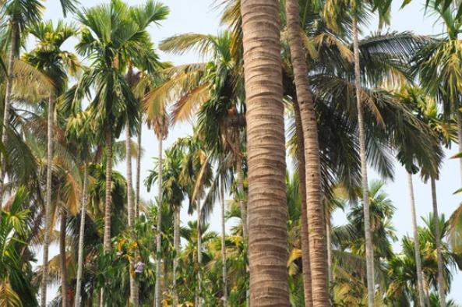
Project ID: RP-24-25J-267​
Overview of
Research Problem
Challenges in detecting diseases and assessing growth due to tree height and scale of farms.​
Traditional methods of disease detection, pests detection and maturity assessment are labor-intensive and often inefficient.​
Methodologies lack a comprehensive approach to addressing all aspects of coconut tree health and productivity​.
With the advancement of technology, by utilizing drones, and IoT nodes, to retrieve more accurate data taken in real-time and using most accurate algorithms we can significantly improve the early detection and management of diseases, pest attacks, soil fertility, and harvest prediction.​

Slide 6
Project ID: RP-24-25J-267​
Research
Objectives
Main Objective​
Early Disease Detection
To develop an integrated system that utilizes Machine Leaning and Internet of Things with drone-based imaging, NPK sensors, and predictive analytics to enhance disease detection, pest attacks, soil fertility management, and harvest prediction in coconut cultivation. ​
Pest Detection Management
Soil Fertility Monitoring
Maturity and Harvest Prediction

Slide 7
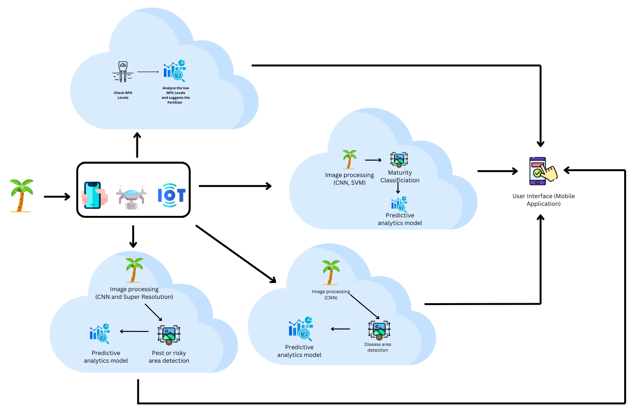
Project ID: RP-24-25J-267​
System Diagram

Slide 8
Project ID: RP-24-25J-267​
IT21305696
Gunarathne M. M. S. U.
Bachelor of Science (Hons) in Information Technology ​

Slide 9
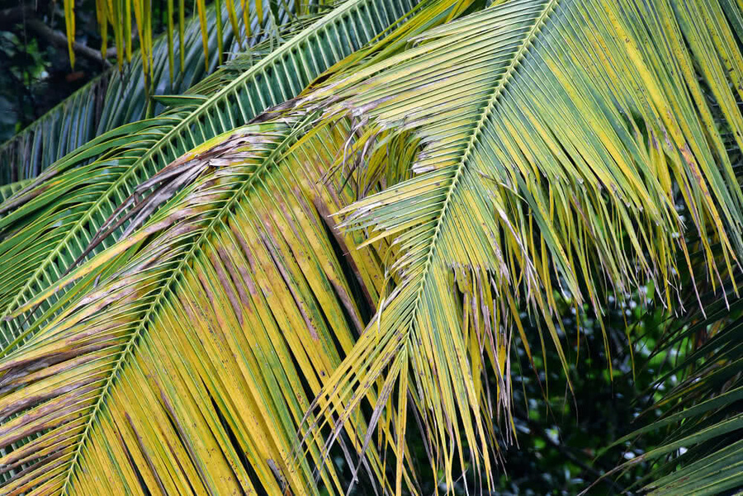
Project ID: RP-24-25J-267​
Introduction of
Disease Detection and Management​
Coconut tree is vital to the economy of Sri Lanka, providing livelihoods for millions and contributing significantly to the agricultural sector.
Diseases such as leaf blight, lethal yellowing, and leaf spot pose serious threats to coconut tree health and productivity.
Early detection and effective management of these diseases are crucial to maintaining healthy coconut plantations and ensuring sustainable yields.​

Slide 10
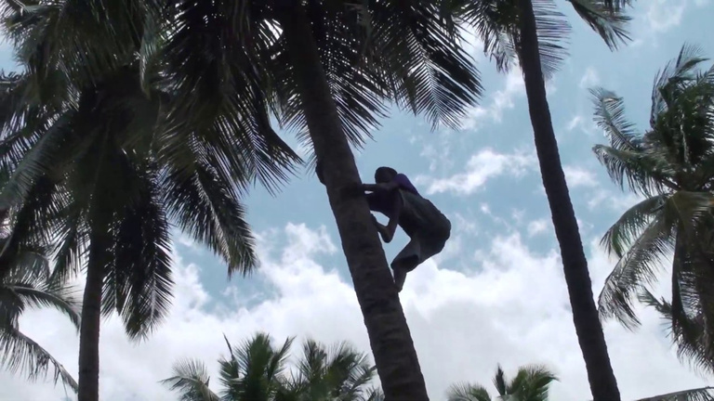
Project ID: RP-24-25J-267​
Overview of
Research Problem
Farmers need to physically inspect trees, which is particularly challenging due to the height of coconut trees and the vast areas they cover.​
Manual inspections often miss early signs of diseases, and leaving these unchecked allows the diseases to spread and cause severe damage.​
Different diseases may look similar when checking manually, making it difficult to differentiate them.​​
Any decline in coconut yield due to diseases directly impacts the economy, causing substantial losses in revenue from both local consumption and exports.

Slide 11
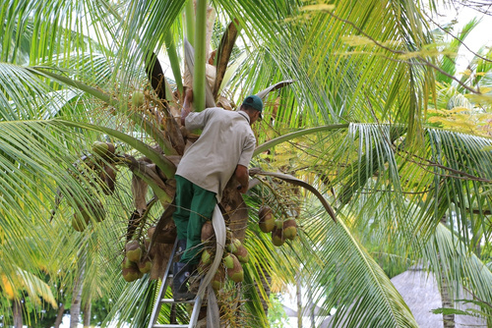
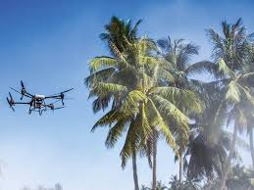
Project ID: RP-24-25J-267​
Research Gap & Novelty
Existing Applications focuses on general agricultural disease detection.​
There are research that are focused on coconut disease detection and management these lack integration with advanced technology.​
My research area addresses this gap by integrating Saliency mapping and Explainable AI to enhance the accuracy and reliability of coconut disease detection.

Slide 12
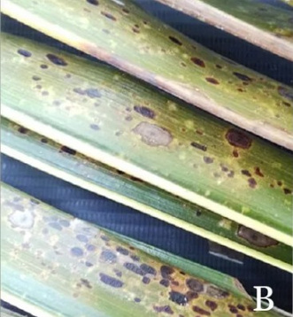

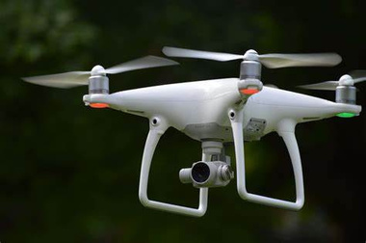
Project ID: RP-24-25J-267​
Research Gap
Disease Prediction in Coconut Leaves using Deep Learning [2]
Focuses only on dried leaves, caterpillar attacks, and yellowing of leaves detection.
This research is based on India
Lacks saliency mapping and XAI techniques, reducing the accuracy, transparency of disease detection.
Coconut Disease Prediction System Using Image Processing and Deep Learning Techniques [1]
Focuses on pest attacks, nutrient deficiencies, missing fungal and bacterial infestations which poses a serious threat
Doesn't use Drone Imagery
Does not provide predictive insights for future pest management, focusing only on current infestations.

Slide 13
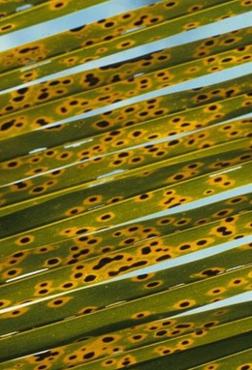
Project ID: RP-24-25J-267​
Research Gap
CONVOLUTIONAL NEURAL NETWORK-BASED IMAGE CLASSIFICATION FOR IMPROVED COCONUT DISEASE IDENTIFICATION [3]
Only targets pest attacks and some diseases, neglecting other fungal and bacterial infestations that affect coconut trees.
Not Based in Sri Lanka
Does not incorporate advanced image processing techniques nor drone imagery, limiting the detection quality of drone-captured images.

Slide 14


Research Gap
Project ID: RP-24-25J-267​
Research [1]
Research [2]
Research [3]
Research [4]
CocoGuard
Saliency Mapping
Integration of Predictive Analysis for disease detection
Explainable
AI
Drone-Based Image Collection and Analysis
Advanced Image Processing
Comprehensive Disease Management
10

Slide 15
Project ID: RP-24-25J-267​
Sub Objectives
Develop an automated system to detect leaf blight, lethal yellowing, and leaf spot disease in coconut trees using drones and ML/DL algorithms.
Integrate saliency mapping and explainable AI to enhance disease detection accuracy and transparency.​
Provide actionable insights and management recommendations to farmers based on detected diseases​.
Saliency Mapping - highlights the most important parts of an image that influence the model's predictions
Explaianable AI - provides insights into how the model arrives at its conclusions

Slide 16
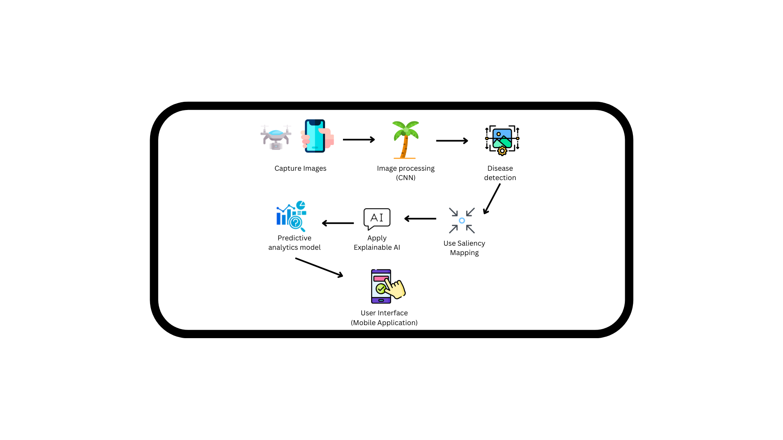
Project ID: RP-24-25J-267​
System Diagram
Disease Detection and Management

Slide 17
Project ID: RP-24-25J-267​
Functional and Non-Functional Requirements
Functional​ | Non-functional
Image Capture and Upload | Performance
Disease Detection | Reliability
Disease Management Recommendations | Usability

Slide 18


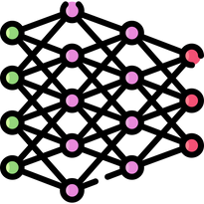


Project ID: RP-24-25J-267​
Tools and
Technologies to be used
Jupyter
Drone Imagery
CNN
Matplotlib
Captum
Develop, train, and evaluate machine learning models
Collect Images
Used for Image Classification, Object Detection, Image Segmentation
Useful for visualizing saliency maps
Library for PyTorch that offers several algorithms for explaining model predictions,

Slide 19
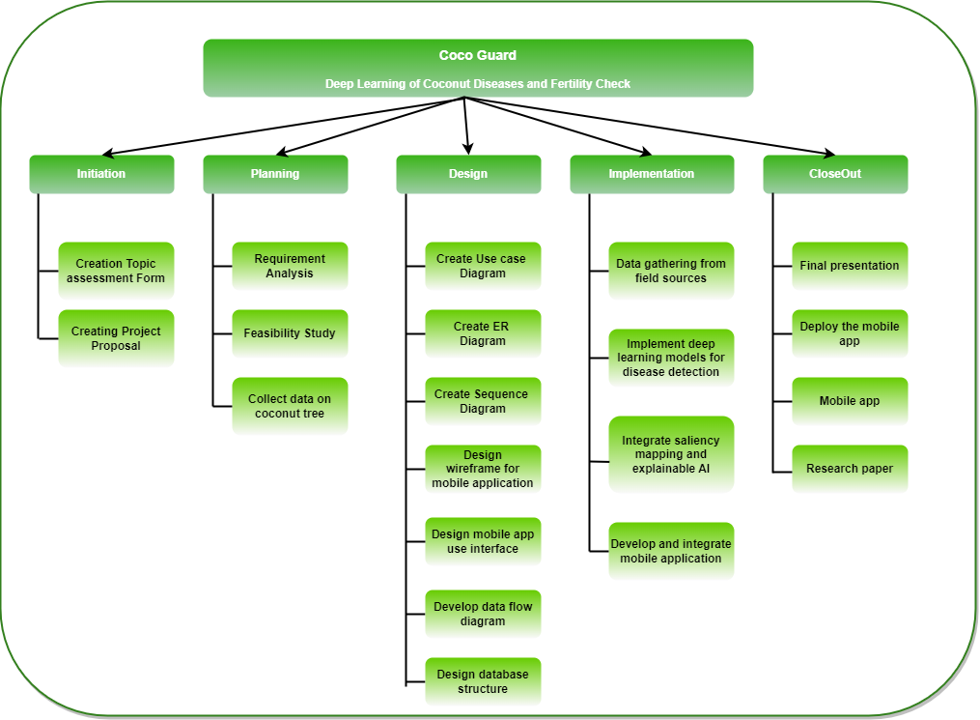
Project ID: RP-24-25J-267​
Work Breakdown (WBS)

Slide 20

Project ID: RP-24-25J-267​
References
[1] D. Nesarajan, L. Kunalan, M. Logeswaran, S. Kasthuriarachchi,& D. Lunugalage (2020). “Coconut Disease Prediction System Using Image Processing and Deep Learning Techniques” 2020 IEEE 4th International Conference on Image Processing, Applications and Systems (IPAS), pp. 212-217
[2] Anitha.B, & Dr.Santhi.S (2023). “Disease Prediction in Coconut Leaves using Deep Learning” International Conference on Sustainable Computing and Data Communication Systems (ICSCDS-2023), pp. 258-264
[3] C. D. L. Montero,B. J. A. Gundul, J. G. Frayco, & J. Q. Candia Jr (2023) “Convolutional Neural Network-Based Image Classification for Improved Coconut Disease Identification”, SDSSU Multidisciplinary Research Journal (SMRJ) Vol. 11, June 2023, pp. 2408-3577 (Online)
[4] T. Nivethitha, P. Vijayalakshmi, J. Jaya, & S. Shriram (2022). “A Review on Coconut Tree and Plant Disease Detection using various Deep Learning and Convolutional Neural Network Models” 2022 International Conference on Smart and Sustainable Technologies in Energy and Power Sectors (SSTEPS), pp. 130-135
[5] Wijethunga C.D, Ishanka K.C, Parindya S.D.N, Priyadarshani T.J.N, Buddika Harshanath & Samantha Rajapaksha (2023), “Coconut Plant Disease Identified and Management for Agriculture Crops using Machine Learning”, International Journal of Engineering and Management Research Volume-13, Issue-5 (October 2023), pp. 79-88

Slide 21
Project ID: RP-24-25J-267​
IT21348648
Balasooriya R. C.​
Bachelor of Science (Hons) in Information Technology ​

Slide 22
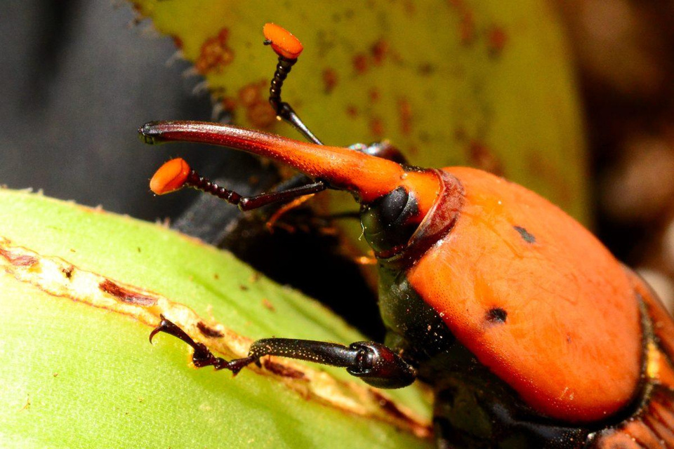
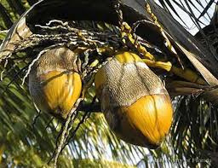
Project ID: RP-24-25J-267​
Introduction of
Pest Detection and Management​
This research area focuses on developing a machine-learning model to detect red weevil and mite attacks on coconut trees. These pests reduce harvest and weaken trees, sometimes causing death. By using image processing and predictive analysis, our system can identify attacks early and recommend necessary actions to mitigate damage.​

Slide 23
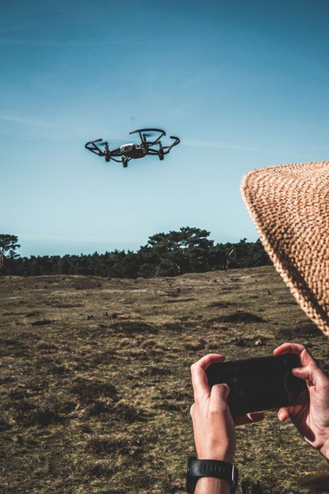
Project ID: RP-24-25J-267​
Overview of
Research Problem
Hard to reach- Hard to see early signs of pest damage on tall coconut trees, leading to late treatments and big losses.​
Need expertise- Farmers spend a lot hiring experts to find and manage pests, which can be expensive, especially for small farmers.​
Risky for farmers- Difficult and dangerous for farmers to inspect tall trees regularly. Using drones helps safely reach and check for pest attacks.​​

Slide 24
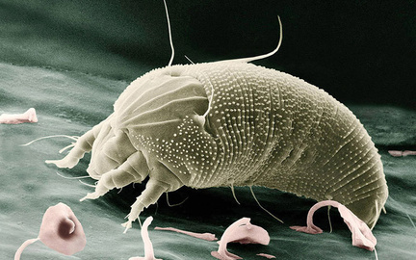
Project ID: RP-24-25J-267​
Research Gap
Wireless Implementation of MEMS Accelerometer to Detect Red Palm Weevil on Palms [1]
Focuses on signal-based detection, missing the potential of visual analysis for pest identification.
Lacks advanced image processing or super-resolution techniques, reducing the accuracy of pest detection.
IoT-based Red Palm Weevil Early Detection and Tracking System [2]
Convolutional Autoencoder-based Deep Learning Model for Identification of Red Palm Weevil Signals [3]
Only targets red palm weevil, neglecting other pests that affect coconut trees.
Does not incorporate super-resolution techniques, limiting the detection quality of drone-captured images.
Relies on signal data rather than high-quality images for detection, missing out on visual pest identification.
Does not provide predictive insights for future pest management, focusing only on current infestations.

Slide 25
Project ID: RP-24-25J-267​
Research Gap
Red Palm Weevil Detection System for Early Warning and Mitigation of Crop Loss [4]
Uses basic detection methods without image enhancement, reducing accuracy in identifying early pest infestations.
Lacks AI-driven predictive analysis for proactive pest management, offering only reactive solutions.

Slide 26
Research Gap
Project ID: RP-24-25J-267​
Research [1]
Research [2]
Research [3]
Research [4]
Research [5]
Your Research
Super-Resolution Imaging
Integration of Predictive Analysis
Comprehensive Pest Detection
Drone-Based Image Collection and Analysis
Advanced Image Processing
Comprehensive Pest Management

Slide 27
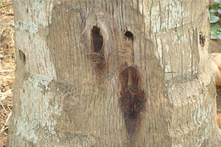
Sub Objective
Project ID: RP-24-25J-267​
Main Objectives
Main Objectives​
Enhancing pest detection accuracy using super resolution technology to improve image quality and identify hard-to-detect infestations.
Sub Objectives​
Develop an automated system to detect red weevil and mite attacks on coconut trees using drones and super-resolution-enhanced image processing.​
Implement machine learning models to accurately identify pest infestations and analyze potential damage.​
Provide predictive analysis and actionable pest control recommendations to farmers, ensuring timely and effective interventions.​

Slide 28
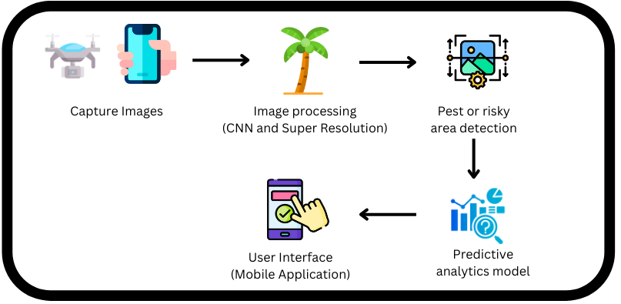
Project ID: RP-24-25J-267​
System Diagram
Pest Detection and Management

Slide 29
Project ID: RP-24-25J-267​
Functional and Non-Functional Requirements
Functional​ | Non-functional
Image Capture and Upload | Performance
Pest and risky area Detection | Reliability
Pest Management Recommendations | Usability

Slide 30








Project ID: RP-24-25J-267​
Tools and
Technologies to be used
Drone
Flutter
Tensorflow
opencv
Python
MatLab
AWS
Get images
Use for develop Mobile App
Use to build and develop CNN model
Use for super resolution technology.
Use to develop machine learning model and creating scripts to perform predictive analytics.
For advanced image processing and testingsuper resolution.
For storing images

Slide 31
Project ID: RP-24-25J-267​
Work Breakdown (WBS)

Slide 32
Project ID: RP-24-25J-267​
Referances
1. M. M. Mansour, M. O. El-Gohary, A. H. El-Helw, and W. A. Al-Kashif, "Wireless implementation of MEMS accelerometer to detect red palm weevil on palms," *2020 IEEE International Conference on Engineering and Technology (ICET)*, Cairo, Egypt, 2020, pp. 1-5. doi: [10.1109/ICET49848.2020.9358486](https://doi.org/10.1109/ICET49848.2020.9358486).
2. F. Hussain, M. W. Ashraf, M. M. I. Rashid, and A. Al-Saggaf, "IoT-based Red Palm Weevil Early Detection and Tracking System," *2020 International Conference on Computational Intelligence (ICCI)*, Islamabad, Pakistan, 2020, pp. 50-55. doi: [10.1109/ICCI51257.2020.9247706](https://doi.org/10.1109/ICCI51257.2020.9247706).
3. N. K. K. Munir, H. Zainuddin, and S. A. Samad, "Convolutional Autoencoder-based Deep Learning Model for Identification of Red Palm Weevil Signals," *2019 IEEE 7th Conference on Systems, Process and Control (ICSPC)*, Malacca, Malaysia, 2019, pp. 89-94. doi: [10.1109/ICSPC47137.2019.9068063](https://doi.org/10.1109/ICSPC47137.2019.9068063).
4. A. A. Shaikh and S. T. Jan, "Red Palm Weevil Detection System for Early Warning and Mitigation of Crop Loss," *2021 IEEE International Conference on Engineering, Technology, and Innovation (ICE/ITMC)*, Cardiff, UK, 2021, pp. 1-7. doi: [10.1109/ICE/ITMC52061.2021.9570024](https://doi.org/10.1109/ICE/ITMC52061.2021.9570024).
5. D. Nesarajan, L. Kunalan, M. Logeswaran, S. Kasthuriarachchi,& D. Lunugalage (2020). “Coconut Disease Prediction System Using Image Processing and Deep Learning Techniques” 2020 IEEE 4th International Conference on Image Processing, Applications and Systems (IPAS), pp. 212-217

Slide 33
Project ID: RP-24-25J-267​
Growth and Fertility Management
Adithya E.L.A.Y.
IT21193736
Bachelor of Science (Hons) in Information Technology ​

Slide 34
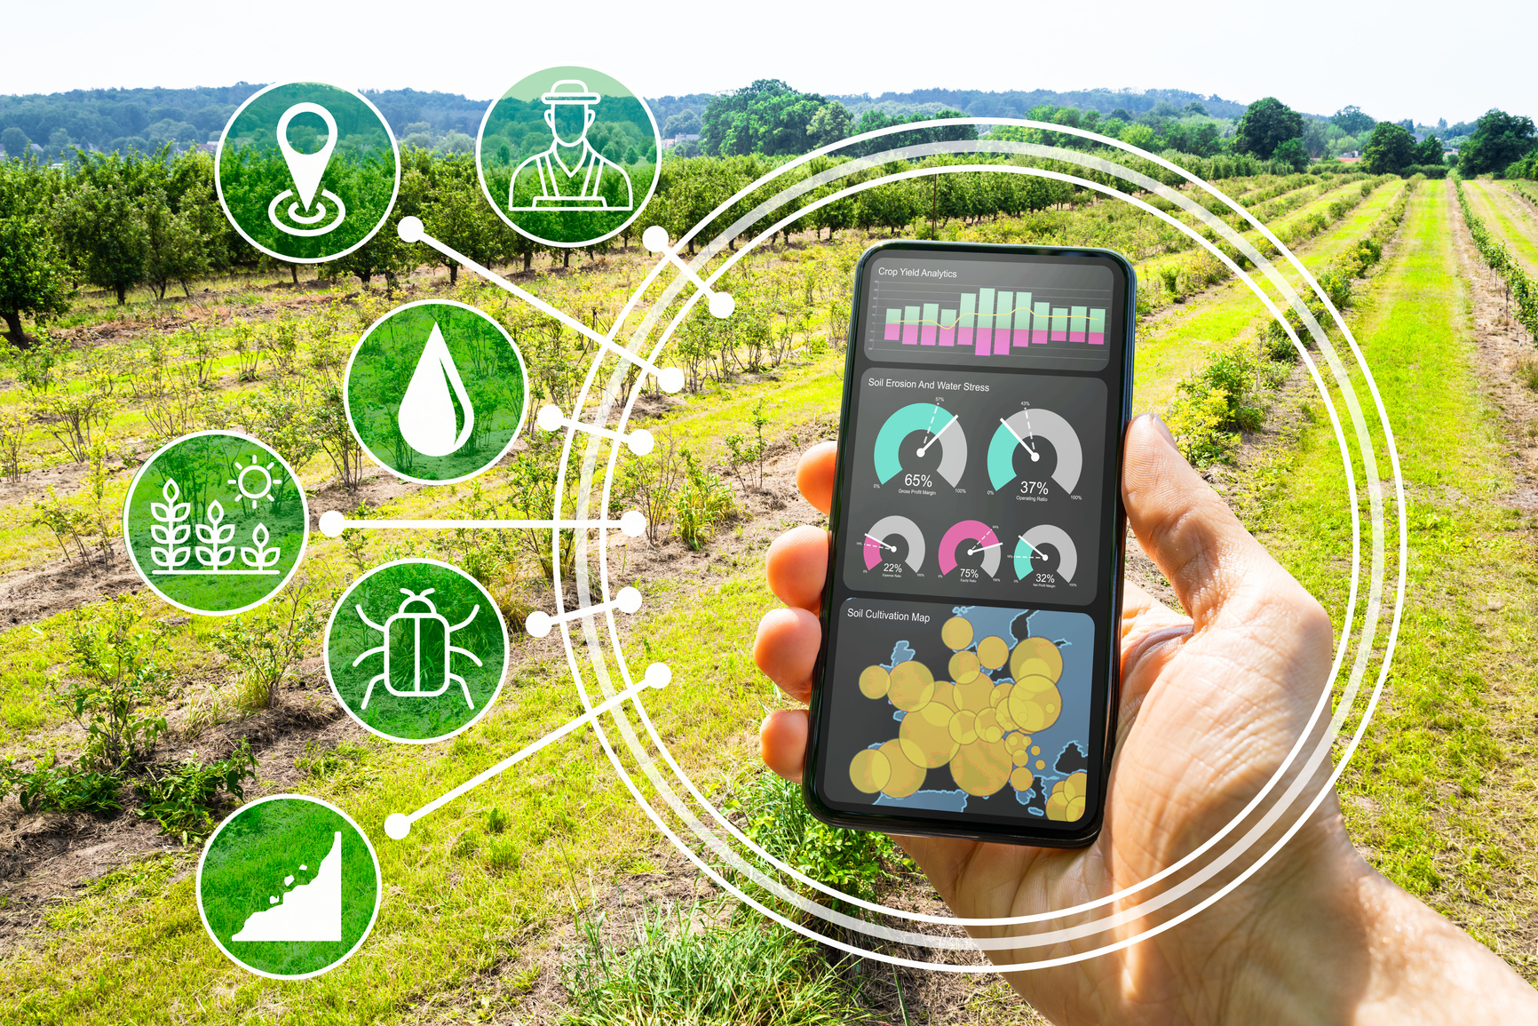
Project ID: RP-24-25J-267​
Introduction of
Growth and Fertility Management
In coconut farming, the application of NPK (Nitrogen, Phosphorus, and Potassium) fertilizers is crucial for ensuring healthy growth, higher yields, and better-quality of coconuts.
This solution uses NPK sensors to monitor soil fertility in real-time, providing tailored fertilizer recommendations to ensure optimal nutrient levels for healthy coconut tree growth.

Slide 35
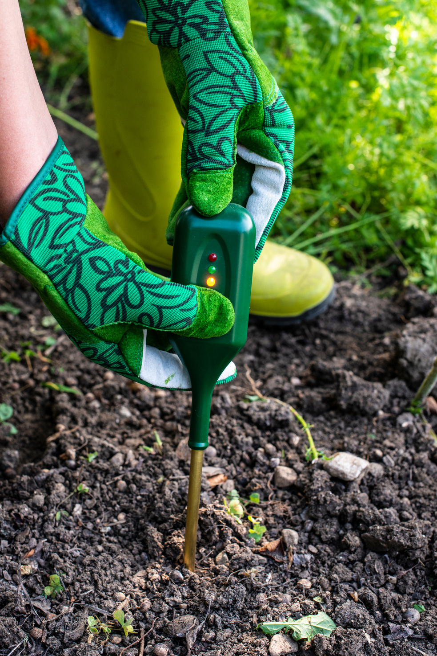
Project ID: RP-24-25J-267​
Overview of
Research Problem
Today, coconut farmers in Sri Lanka have reduced the productivity of coconut cultivation due to the regular application of coconut fertilizers.
Coconut growers not being able to check the quality of the soil every six months
Although the soil samples were tested by the Sri Lanka Coconut Research Institute, it took a very long time and cost a lot.

Slide 36
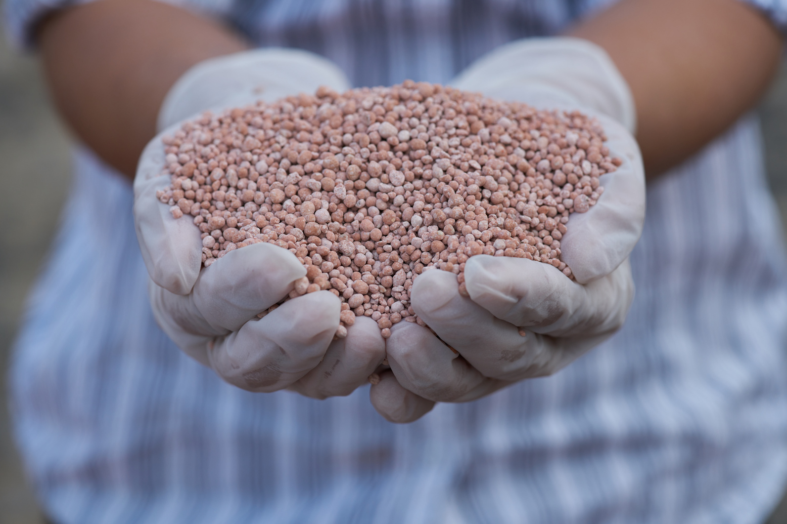
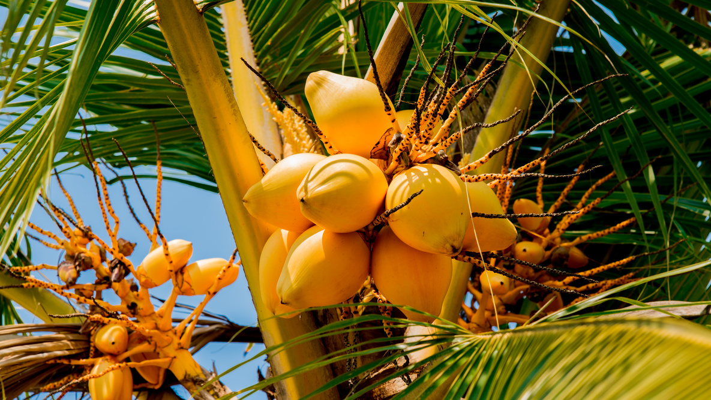
Project ID: RP-24-25J-267​
Novelty
But with this IoT device and mobile application, the components of the soil can be identified and the amount of fertilizer required for that soil can be determined very quickly and at a low cost.
By determining the soil components of coconut varieties native to Sri Lanka, it is possible to increase the yield of those varieties and increase the quantity of those varieties.

Slide 37
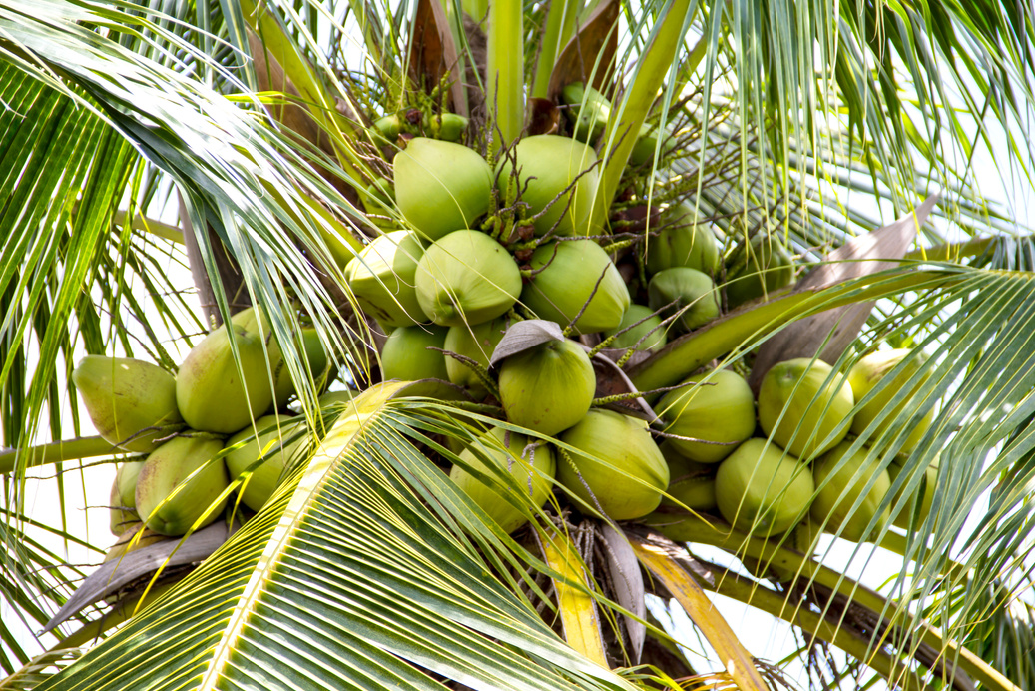
Project ID: RP-24-25J-267​
Sub Objectives
By attaching the IOT device to the soil, the amount of NPK present in the soil can be found and the required amount of NPK can be added to the soil.

Slide 38
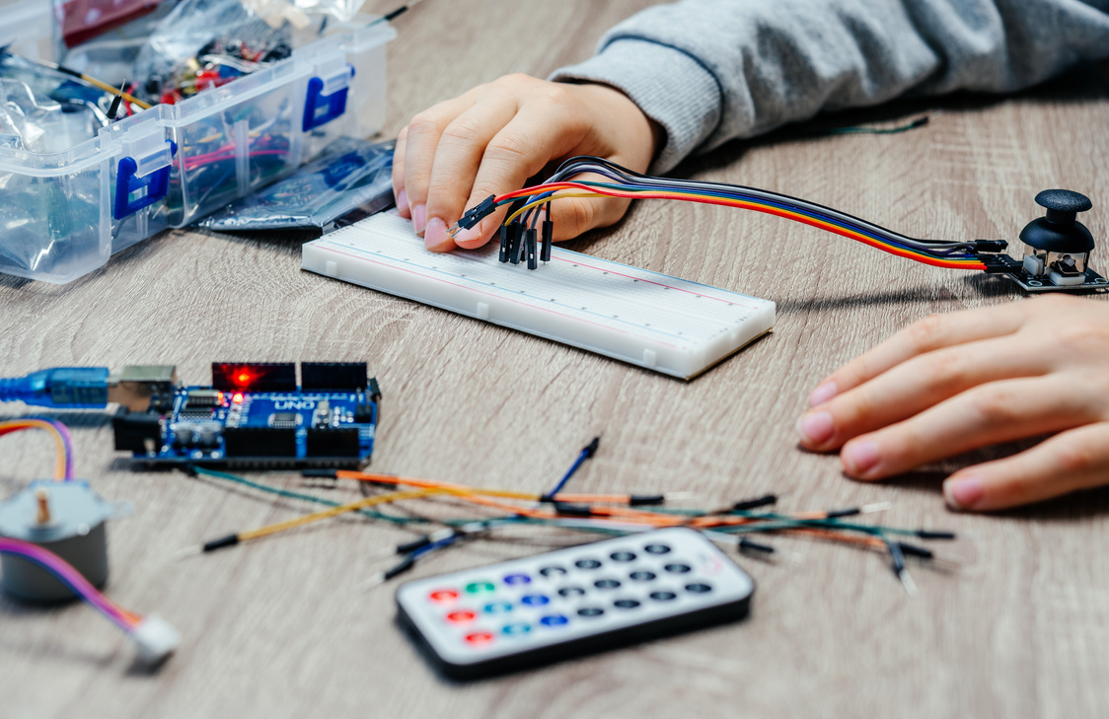
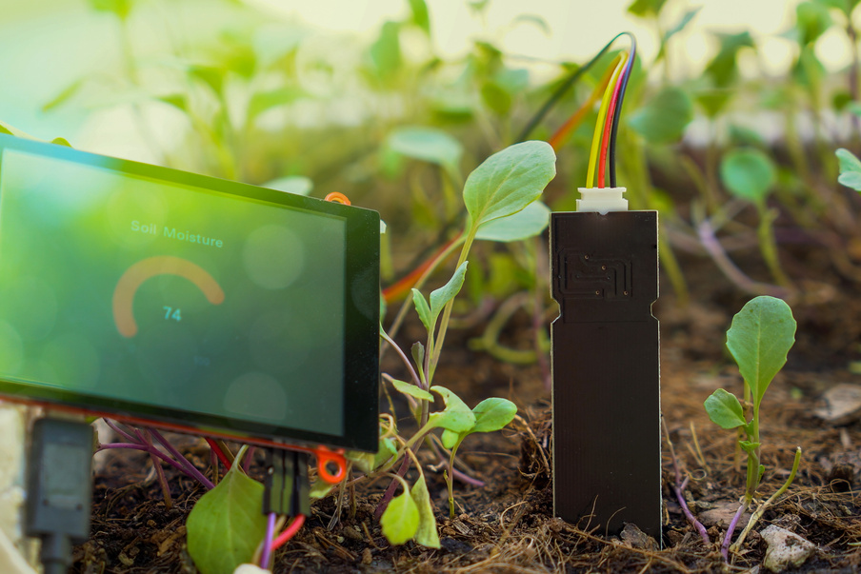
Project ID: RP-24-25J-267​
Research Gap
AN IoT BASED SECURE SMART FARMING
This research for some farming crops.
This research implement the NPK IOT device and Mobile app but it can’t use for Sri Lankan Coconut Growing.
Determining which fertilizers are appropriate by determining soil constituents from a diseased coconut plantation
Incorporation of soil data of coconut varieties indigenous to Sri Lanka
Using mobile phone software and IoT devices to quickly identify what fertilizer is needed for coconut cultivation
Cloud-based Storage

Slide 39
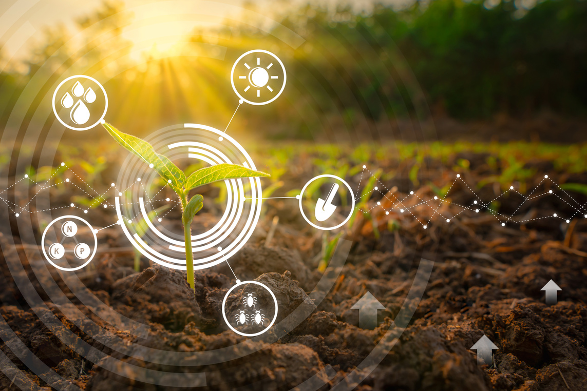
Project ID: RP-24-25J-267​
Research Gap
AI Based IoT Framework for Soil Analysis and Fertilization Recommendation for Smart Coconut Farming
This experiment obtains the NPK level but does not provide the required amount of fertilizer.
And this research use for only India.
Incorporation of soil data of coconut varieties indigenous to Sri Lanka
Using mobile phone software and IoT devices to quickly identify what fertilizer is needed for coconut cultivation

Slide 40
Research Gap
Project ID: RP-24-25J-267​
Research [1]
Research [2]
CocoGuard
Determining which fertilizers are appropriate by determining soil constituents from a diseased coconut plantation
Incorporation of soil data of coconut varieties indigenous to Sri Lanka
Using mobile phone software and IoT devices to quickly identify what fertilizer is needed for coconut cultivation
Cloud-based Storage

Slide 41



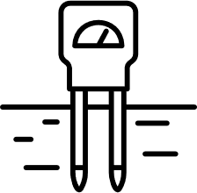
Project ID: RP-24-25J-267​
System Diagram
Disease Detection and Management
Check NPK Levels
Analyze the low NPK Levels
and suggests the Fertilizer
User Interface (Mobile Application)

Slide 42
Project ID: RP-24-25J-267​
Functional and Non-Functional Requirements
Functional​ | Non-functional
Get NPK Levels | Performance
Analyze the Low NPK Levels | Reliability
Determination of fertilizer quantities | Usability

Slide 43
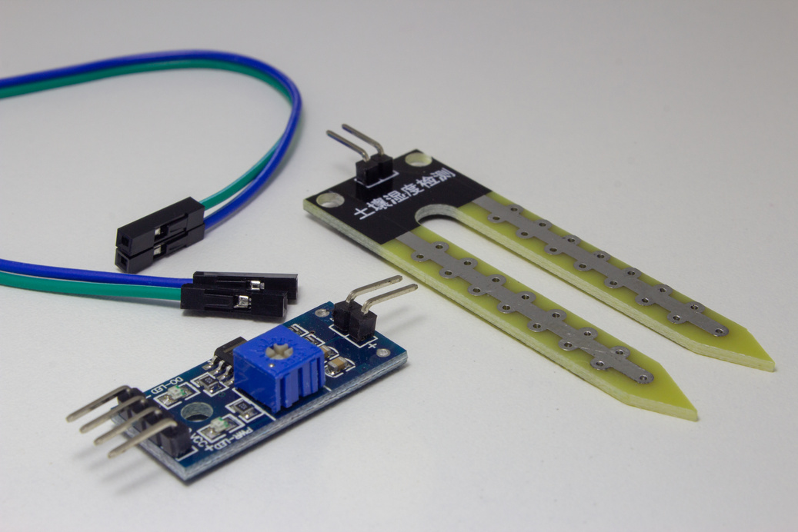
Project ID: RP-24-25J-267​
Tools and
Technologies to be used
NPK sensor
Arduino Nano Board
0.96" OLED Display
MAX485 Modbus Module
9-12V DC Power Supply
Connecting Wires
Breadboard
Data Analytics Platforms
Machine Learning and Deep Learning Algorithms

Slide 44
Project ID: RP-24-25J-267​
Tools and
Technologies to be used
IOT Device
Flutter
Tensorflow
Python
Get NPK levels
Use for develop Mobile App
Use to build and develop CNN model
Use to develop machine learning model and creating scripts to perform predictive analytics.

Slide 45
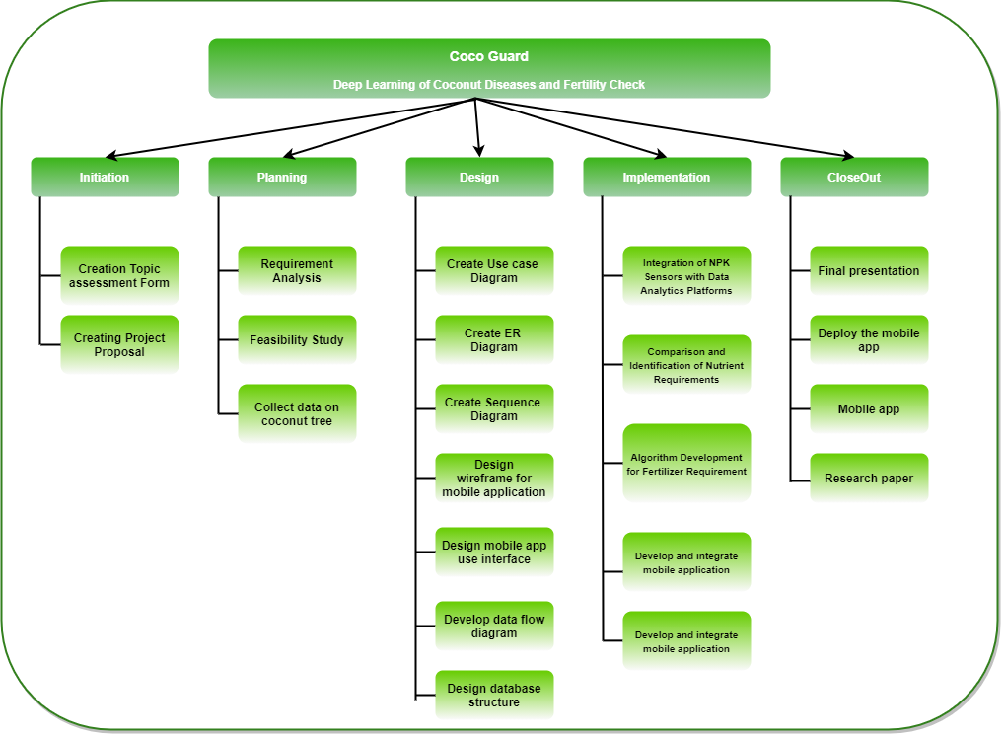
Project ID: RP-24-25J-267​
Work Breakdown (WBS)

Slide 46
Project ID: RP-24-25J-267​
Referances
[1] S. Tan, C. Promdee, and S. Khuntawee, "IoT for Smart Farm: A Case Study of the Fertilizer Mixer Prototype," *International Journal of Engineering Research and Technology (IJERT)*, vol. 9, no. 6, pp. 1-4, Jun. 2020.
[2] R. V. Prasad, R. K. Gupta, and A. Verma, "AI-Based IoT Framework for Soil Analysis and Fertilization Recommendation for Smart Coconut Farming," *International Journal of Scientific Research in Computer Science and Engineering*, vol. 9, no. 2, pp. 1-6, Apr. 2021.
[3] A. Adhikari, "Impact of Fertilizer Application on Soil Fertility in Coconut Cultivation," Coconut Research Institute, Lunuwila, Sri Lanka, 2021. [Online]. Available: https://cri.gov.lk/wp-content/uploads/2021/10/a5.pdf. [Accessed: Aug. 15, 2024].

Slide 47
Project ID: RP-24-25J-267​
IT21296932
Silva
T. C. D.
Bachelor of Science (Hons) in Information Technology ​

Slide 48
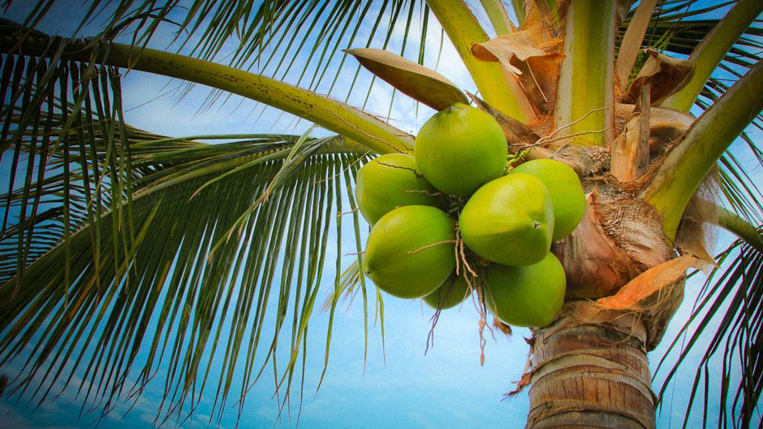
Project ID: RP-24-25J-267​
Introduction of
Maturity and Harvest Management​
Growing coconuts is important for Sri Lanka’s economy, helping many people make a living and boosting the farming industry.
Proper maturity and harvest management are key to getting the best yield and quality from coconut production.
Using new technologies to check maturity and decide the right time to harvest can improve productivity and profits.

Slide 49
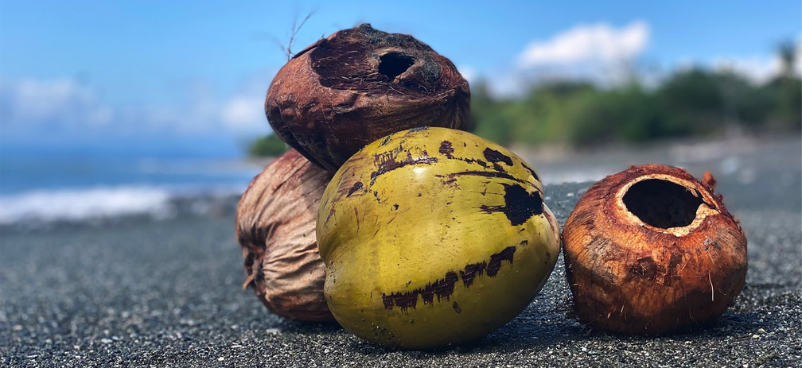
Project ID: RP-24-25J-267​
Overview of
Research Problem
Time consuming- Current methods for assessing coconut maturity are slow and require manual monitoring.
Current limitations - Manual methods and basic image processing often lead to errors, reducing yields and profits.
Need for automation - A system using drone images and historical data can accurately predict harvest times, helping farmers maximize yield and quality.

Slide 50
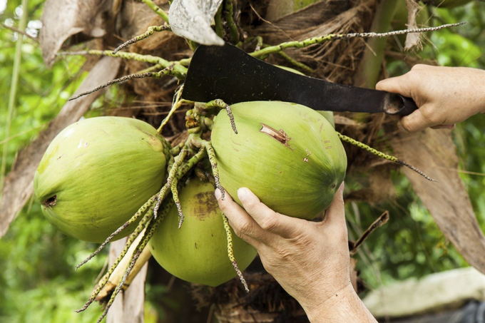
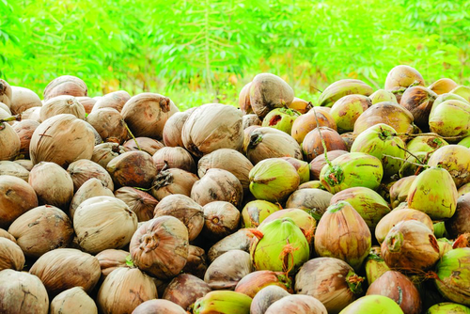
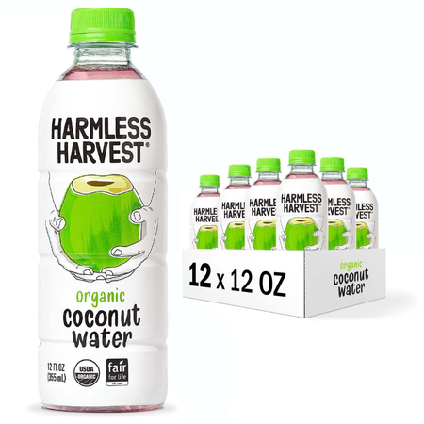
Project ID: RP-24-25J-267​
Research Gap
Coconut Maturity Detection System using CNN Model with ResNet50 Architecture [1]
Focuses on identifying coconut maturity stages using image processing techniques and CNN models.
Doesn't use Drone Imagery
Lacks predictive models for determining the optimal harvest time to maximize crop yield for better productivity.

Slide 51
Project ID: RP-24-25J-267​
Research Gap
On-Tree Coconut Maturity Estimation and Age Prediction Using Machine Vision [2]
Focuses on using CNN for on-tree coconut maturity estimation and age prediction through image classification.
Doesn't use Drone Imagery
Does not incorporate predictive models to determine the optimal harvest time.

Slide 52
Project ID: RP-24-25J-267​
Research Gap
On-tree Mature Coconut Fruit Detection based on Deep Learning using UAV images [4]
Focuses on using UAVs and YOLOv5 for real-time detection of mature coconut fruits to reduce harvesting risks.
Not Based in Sri Lanka
Does not include predictive models for optimal harvest timing.

Slide 53
Research Gap
Project ID: RP-24-25J-267​
Predictive Analysis for Harvest Timing
Machine Learning for Maturity Detection
Drone-Based Image Collection
Integration of Past Harvest Data
Cloud-based Storage
Research [1]
Research [2]
Research [3]
Research [4]
CocoGuard

Slide 54
Project ID: RP-24-25J-267​
Novelty
Existing research primarily focuses on detecting coconut maturity or identifying visible mature fruits using image data and machine learning models.
These approaches lack predictive models that determine the optimal harvest time to maximise crop yield.
My research uniquely addresses this gap by integrating image data with past harvest records to develop a predictive model, guiding farmers on the best time to harvest for maximum productivity.

Slide 55
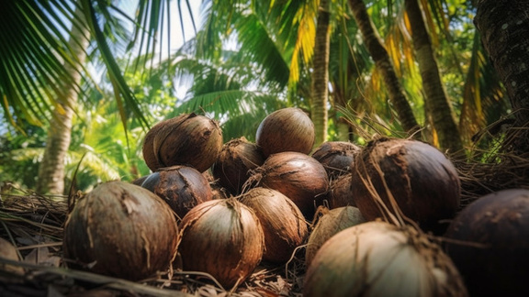
Project ID: RP-24-25J-267​
Sub Objectives
Develop an automated system to assess the maturity of coconuts using drones and machine learning.
Integrate predictive models to determine the optimal harvest timing.
Provide actionable insights and management recommendations to farmers based on maturity assessments.

Slide 56
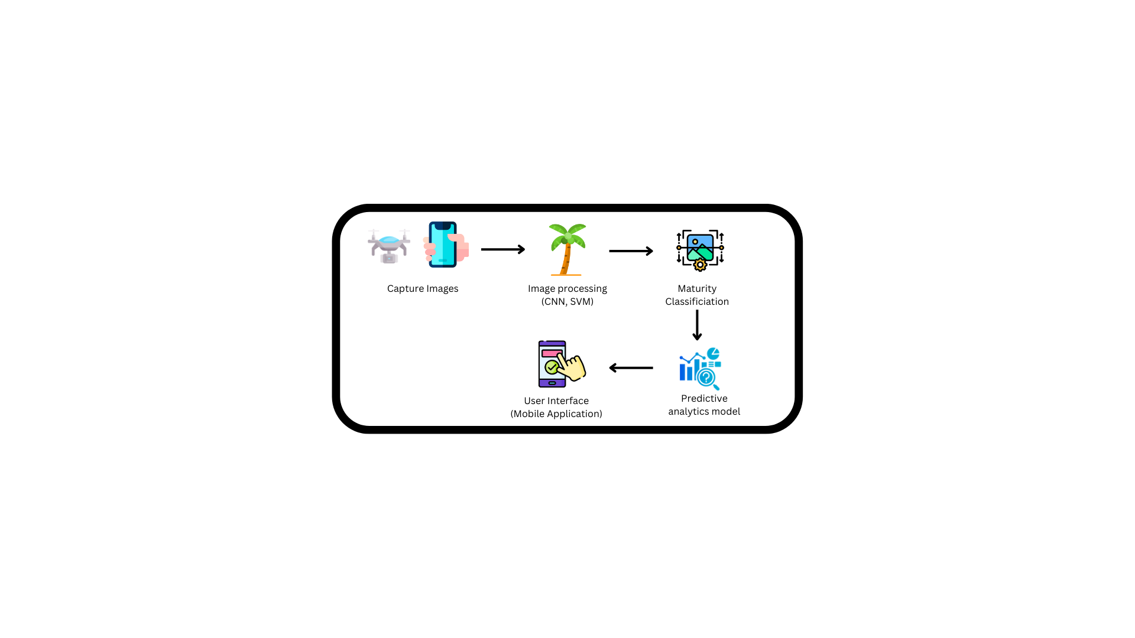
Project ID: RP-24-25J-267​
System Diagram
Maturity and Harvest Management

Slide 57
Project ID: RP-24-25J-267​
Functional and Non-Functional Requirements
Functional​ | Non-functional
Image Capture and Upload | Performance
Maturity Detection | Reliability
Harvest Management Recommendations | Usability

Slide 58
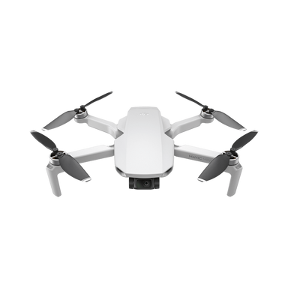



Project ID: RP-24-25J-267​
Tools and
Technologies to be used
Drone Imagery
TensorFlow
RapidMiner
AWS
Apache Kafka
Capture high-resolution images for data analysis in agriculture.
Develop, train, and deploy machine learning models for image processing.
Perform image classification, object detection, and segmentation tasks.
Stream and process real-time data efficiently for predictive analytics.
Storing Images

Slide 59
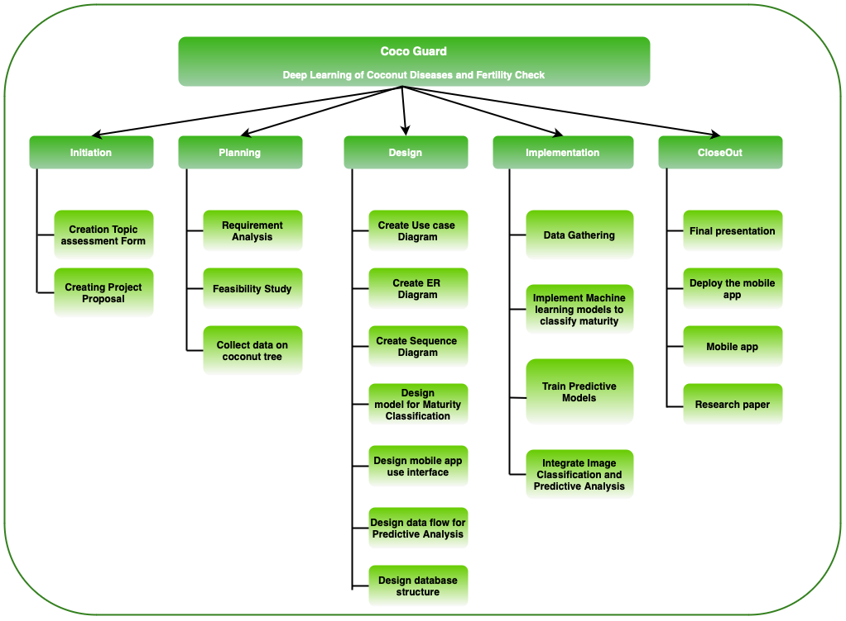
Project ID: RP-24-25J-267​
Work Breakdown (WBS)

Slide 60
Project ID: RP-24-25J-267​
Referances
[1] S. Thillaikkarasi, S. K. Aiswarya, M. Athisha, J. B. Sanjay, and C. Hitesh Reddy, "Coconut Maturity Detection System using CNN Model with ResNet50 Architecture," in *Proc. Seventh Int. Conf. Electronics, Communication and Aerospace Technology (ICECA 2023)*, 2023, pp. 935-940, doi: 10.1109/ICECA58529.2023.10394961.
[2] S. B. S, S. Sasidharan, A. M. H, H. Priya V, P. R, and M. G. Mathew, "On-Tree Coconut Maturity Estimation and Age Prediction Using Machine Vision," in *Proc. 1st Int. Conf. Trends in Engineering Systems and Technologies (ICTEST 2024)*, 2024, doi: 10.1109/ICTEST60614.2024.10576124.
[3] K. K. L. B. Adikaram, A. M. N. N. Senevirathna, W. P. P. M. Wijesinghe, and C. Premachandra, "Image Classification Method to Identify Mature Coconut," in *Proc. Int. Conf. Image Processing and Robotics (ICIPRoB 2024)*, 2024, doi: 10.1109/ICIPRoB62548.2024.10543979.
[4] J. M. Novelero and J. C. Dela Cruz, "On-tree Mature Coconut Fruit Detection based on Deep Learning using UAV images," in *Proc. IEEE Int. Conf. Cybernetics and Computational Intelligence (CyberneticsCom 2022)*, 2022, pp. 494-499, doi: 10.1109/CYBERNETICSCOM55287.2022.9865266.

Slide 61
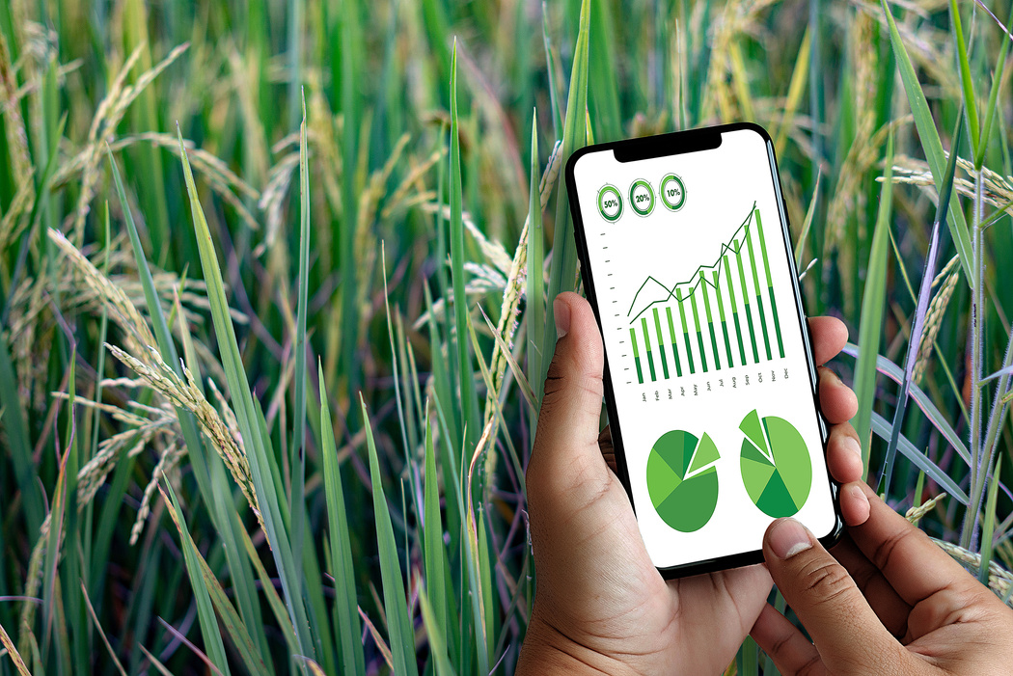

Project ID: RP-24-25J-267​
Commercialization
Small Package
Medium Package
Large Package
Free Application
Small Package
Medium Package
Can detect a disease using Image processing
Can detect a pest attack using image processing
Premium Application
Can rent the drone service through our application
Can buy the IoT device, and the service through our application
Can buy the drone through us
Target Audience - Household coconut tree Farmers
Target Audience - Medium Scale Farmers
Target Audience -
Large Scale Farmers

Slide 62
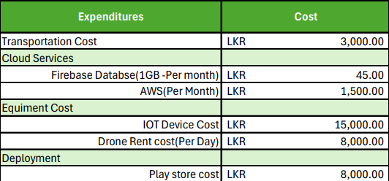
Project ID: RP-24-25J-267​
Budget

Slide 63
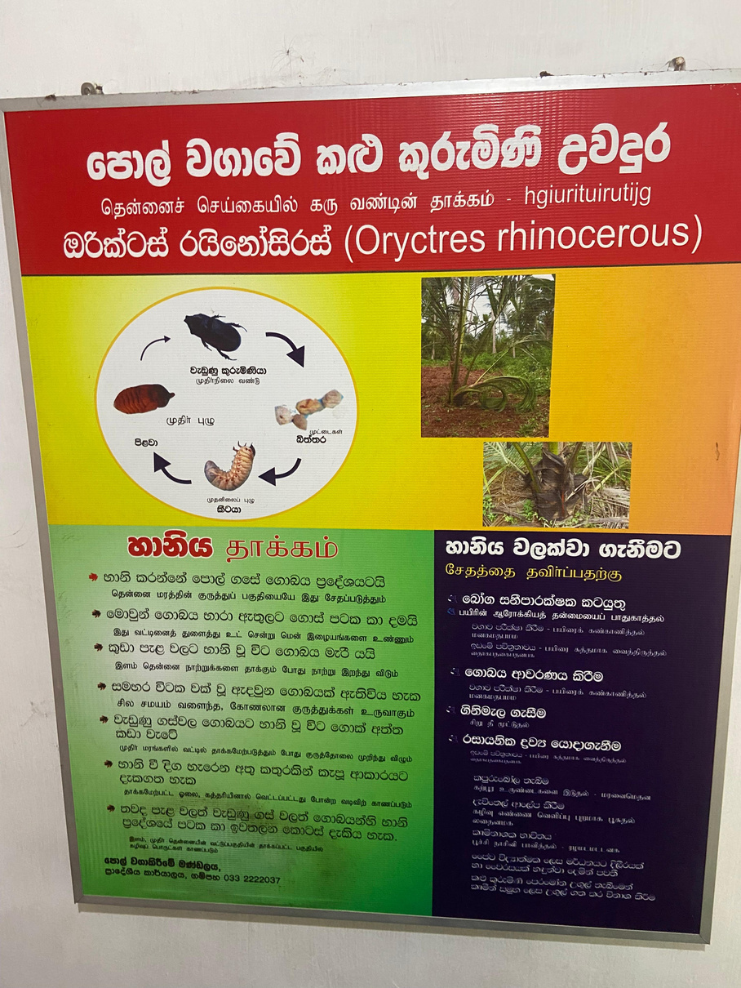
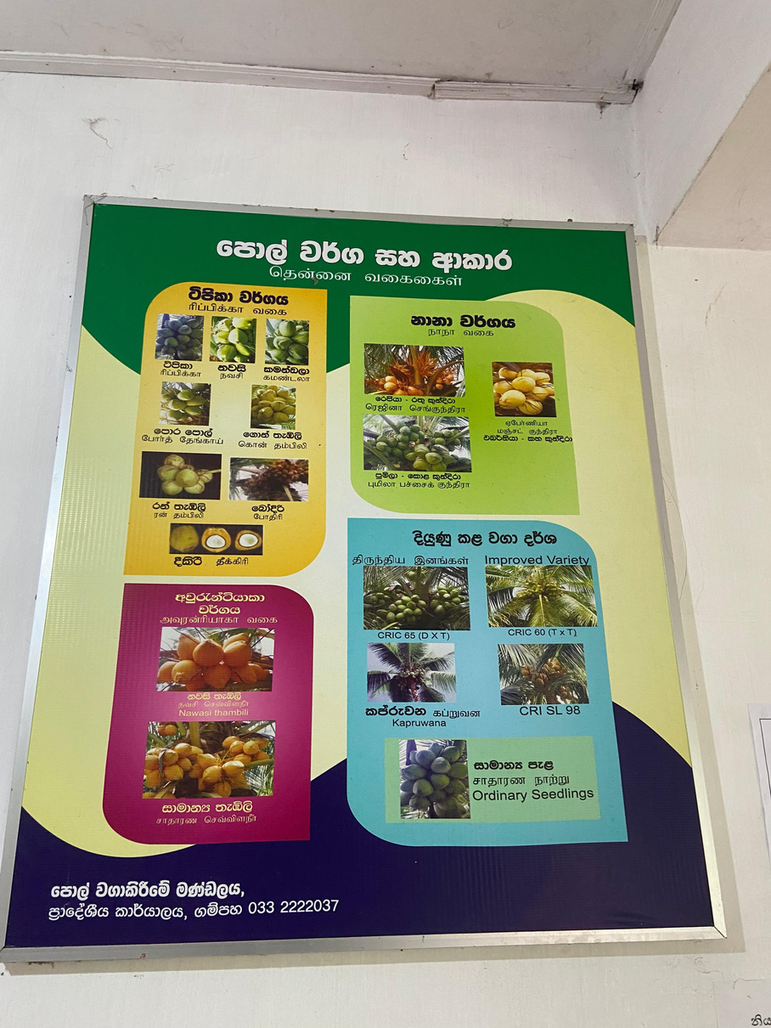



Project ID: RP-24-25J-267​
Site Visit
(Coconut Cultivation Board, Gampaha)

Slide 64

Gannt Chart
Project ID: RP-24-25J-267​

Slide 65

Project ID: RP-24-25J-267​
Thank You

